Slide 1




So You’ve Found a Healthcare Disparity, Now What?
New Visualization Capabilities to Enable Targeted Improvement Initiatives
Rohan R. Chanani¹; Evan W. Orenstein, MD^{2, 3}; Jay Shah, MD^{2, 3}; Sagar D. Mehta, MD^{2, 3}; Brianna P. Glover, MD^{2, 3}; Chris Rees, MD, MPH^{2, 3}; Swaminathan Kandaswamy, PhD ³
¹The Paideia School, Atlanta, Georgia; ²Children’s Healthcare of Atlanta, Atlanta, Georgia; ³Emory University, Atlanta, Georgia

Slide 2
Background: Health Equity Dashboard Literature
Interactive dashboards are becoming more and more valuable to address health disparities
“[A]re these data dashboards meeting their intended promise? Are they useful to public health stakeholders? We believe the answer is rapidly trending toward ‘yes’” (Thorpe, L. et al. 2022).
Existing dashboards only identify disparities, leaving stakeholders wondering what to do next
“[I]dentifying disparities in quality metrics is only the first step to advancing healthcare equity. Eliminating identified disparities requires additional steps, including diagnosing the reasons for identified inequities that are unique to the patient population and healthcare organization in which they occur” (Connolly, M. et al. 2021).
“Future directions include using these data to refine hypotheses on ED disparities, understand root causes, develop interventions, and measure their impact” (Tsuchida, R. et al. 2021).

Slide 3
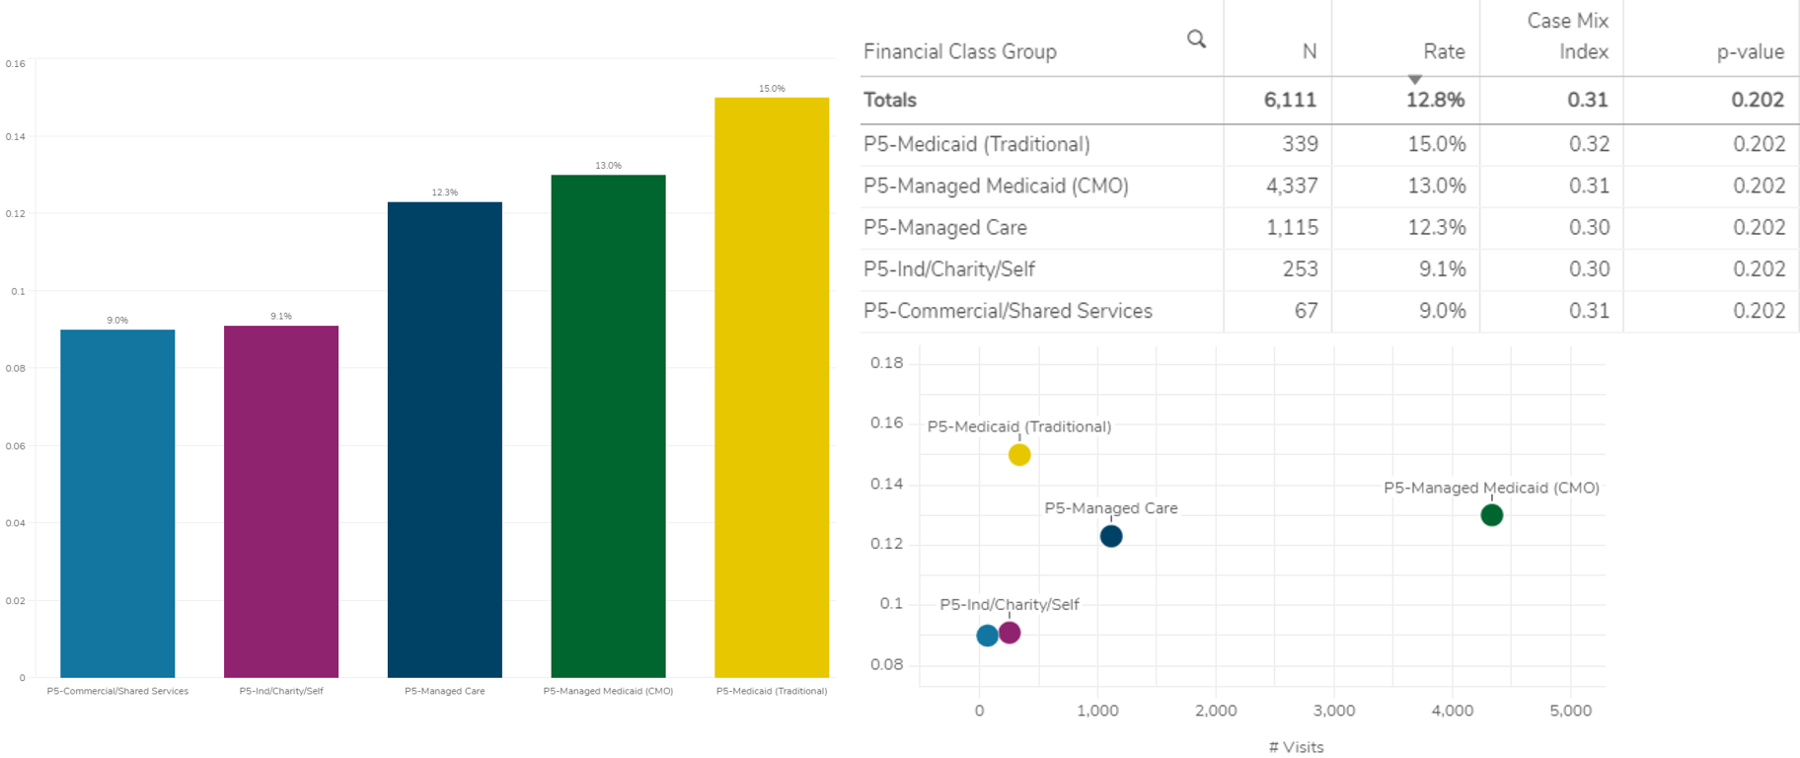
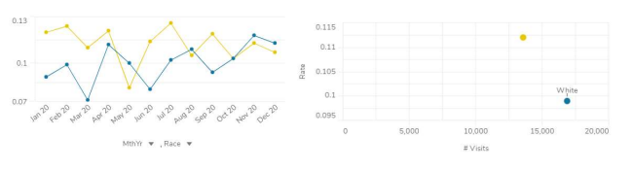
Background: Local
Children’s Healthcare of Atlanta (CHOA) has a descriptive equity dashboard currently in use at the hospital.
This allows users to compare outcome metrics across various social determinants of health within a population.
However, the current dashboard does not provide users with a potential course of action to address discrepancies.
Screenshots of 30 day readmission rates by race and financial class from the health equity dashboard currently in use at CHOA (Kandaswamy, S. et al. 2022)

Slide 4





Background: Conceptual Model to Improve Health Equity
Our goal is to get stakeholders to this stage
Diagnosis: Identify a Healthcare Disparity
Quantitative Analysis: Find hot spots and lowest hanging fruits
Intervention: Design a corrective course of action
Maintenance: Continuously execute Plan, Do, Study, Act cycles
Qualitative Analysis: Enumerate causes, barriers, and opportunities
Most health equity dashboards accomplish this stage (including the current CHOA dashboard)

Slide 5
Research Goal and Specific Objectives
Enable clinicians and health system leaders to intuitively identify healthcare disparities and the sub-populations with the greatest opportunities for improvement.
Define a metric to identify hotspots for targeting interventions
Develop a usable interface to enable identification of the most opportune areas for disparity improvement

Slide 6
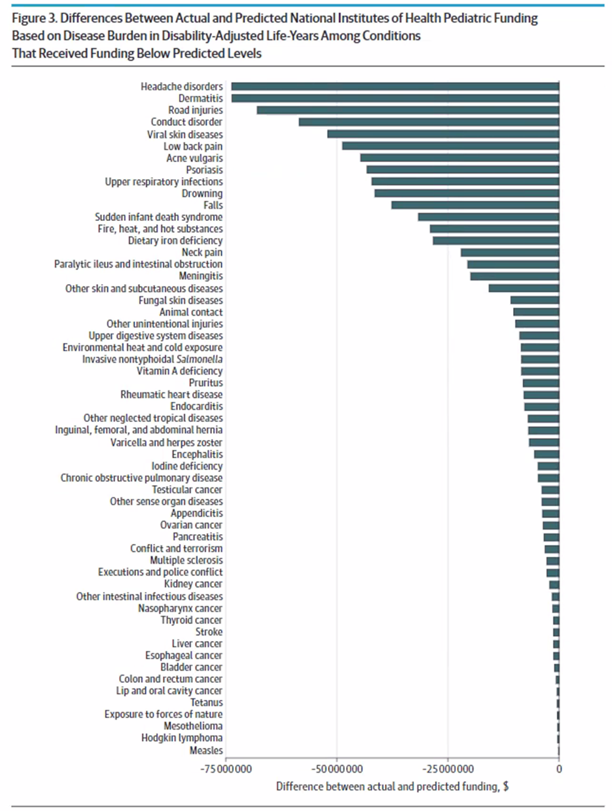
Methodology: Metric Development
Inspiration: “Actual - Predicted” to identify variations from expected
Adaptation: “Actual - Equitable”
Example:
The average Length of Stay (Hours) across all patients with Billing Diagnosis of Acute respiratory failure with hypoxia was 127.89 for n=506 patients, yielding a total of 64712 Hours of Length of Stay.
Among the 506 patients with Billing Diagnosis of Acute respiratory failure with hypoxia, 16% are Hispanic patients. Imagine that the average Length of Stay (Hours) was equal across all Ethnicity groups. In that case, we would expect the 81 Hispanic patients to have 10359.04 total Hours of Length of Stay.
In reality, Hispanic patients had 12967 total Hours of Length of Stay.
The difference of Actual - Equitable is 2607.96 Hours.
The Billing Diagnosis with the highest Actual - Equitable value may give you the most "bang for your buck" to resolve the disparity in Length of Stay by Ethnicity group globally.
Actual - Predicted metric for National Institute of Health funding allocation (Rees, C. et al. 2021)

Slide 7
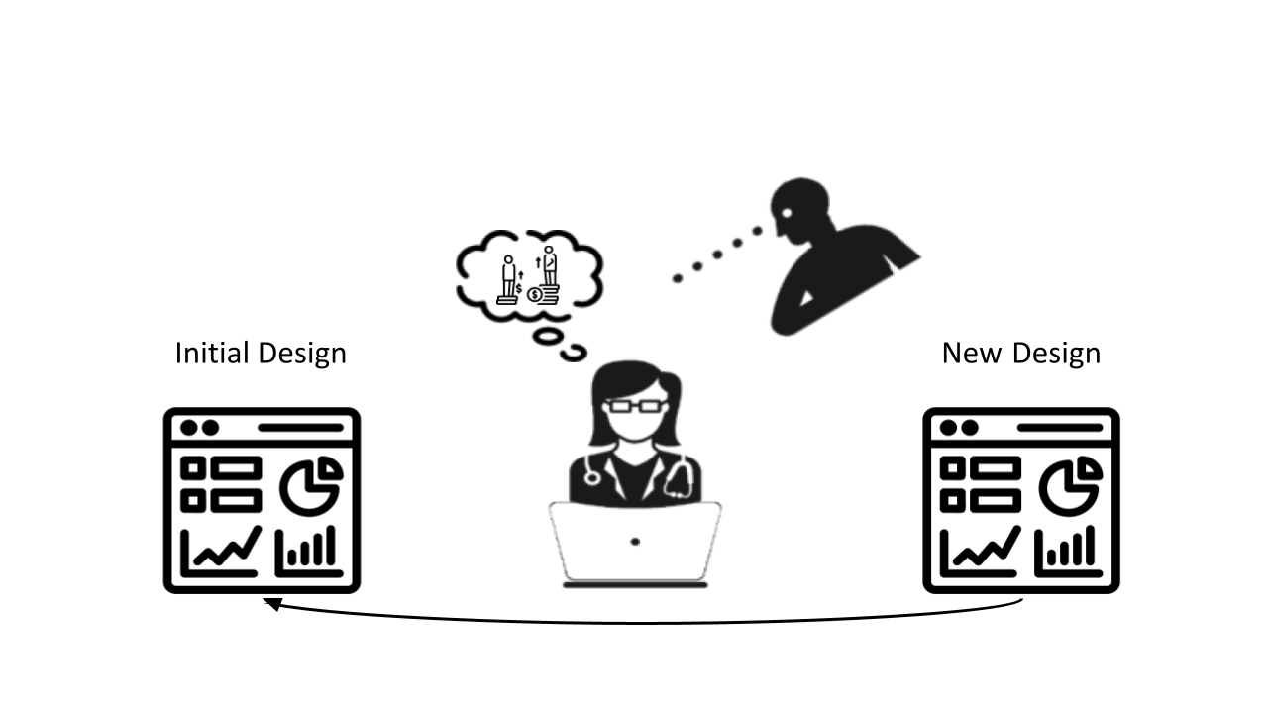
Methodology: User-Centered Design
Formative Usability Testing:
Created a candidate application and interactive user interface (R Shiny)
Created scenarios simulating health system leader tasks
Identify a disparity
Decide on focus area(s)
Observed 7 clinicians of varying expertise interacting with the prototype
“Think Aloud” protocol
Iterative design changes between participants
Design framework for Formative Usability Testing

Slide 8
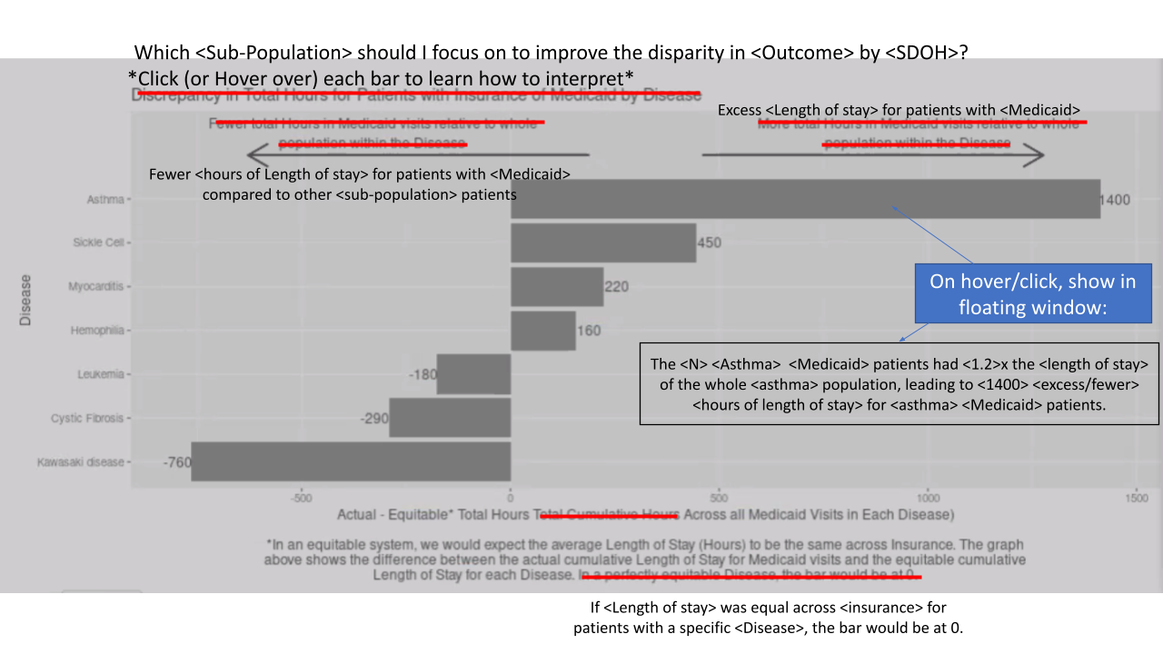
Results: Lessons Learned in Formative Testing
The Challenge: Convey “Actual - Equitable” Concept
Distinguished Tasks
Landing interface provides crude disparities only
e.g. 7 Day Unplanned Readmission Rate by Insurance is 4.7% for Self Pay patients, 6.9% for Public patients, and 6.6% for Private patients.
“Dive Deeper” graphs are labeled with the question they are trying to answer
e.g. Which Zip Code should I focus on to improve the disparity in Length of Stay by Race for Black patients?
Interactive Explanatory Framework
Clicking on individual results exposes detailed calculation and reasoning.
Annotated user interface created during Formative Usability Testing

Slide 9
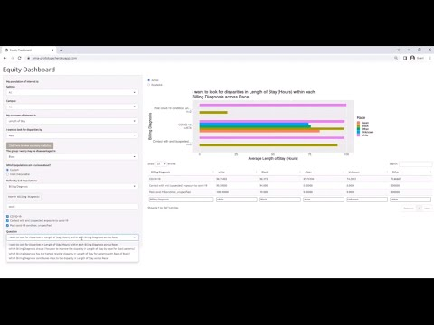
Results: Demo
As shown in the video, the final version of the dashboard prototype has extensive functionality and is able to both identify healthcare disparities and help direct a course of action to reduce them
Additionally, the interface is designed to be flexible and user friendly to make the relevant data easily accessible for clinicians and health system leaders

Slide 10
Results: Feedback from CHOA
“This is exactly the kind of thing we need to be doing” - Chief Diversity Officer
“I can definitely see this being a very useful tool for other clinicians and myself, and even for researchers with addition of p-values and significance” - Pediatric Cardiologist
"This is a different way of looking at problems we have in the system" - Pediatric Interventional Radiologist
"I would hope to have this for many different disease processes and sub-populations” - Pediatric Emergency Medicine Physician

Slide 11
Conclusions and Next Steps
Conclusions
The final dashboard was able to identify specific opportunity areas for improving disparities in the CHOA healthcare system
Additionally, our final rounds of usability testing indicated that users were able to navigate the dashboard and interpret the graph and table data as intended
Next Steps
Integrate the dashboard into the existing software ecosystem at CHOA to allow real-time updates
Execute interventions and PDSA cycles based on insights from the dashboard to see how well the data translate to the actual reduction of disparities

Slide 12
References
Thorpe LE, Gourevitch MN. Data Dashboards for Advancing Health and Equity: Proving Their Promise? Am J Public Health. 2022 Jun;112(6):889-892. doi: 10.2105/AJPH.2022.306847. Epub 2022 Apr 21. PMID: 35446603; PMCID: PMC9137011.
Tsuchida RE, Haggins AN, Perry M, Chen CM, Medlin RP, Meurer WJ, Burkhardt J, Fung CM. Developing an electronic health record-derived health equity dashboard to improve learner access to data and metrics. AEM Educ Train. 2021 Sep 29;5(Suppl 1):S116-S120. doi: 10.1002/aet2.10682. PMID: 34616984; PMCID: PMC8480500.
Connolly M, Selling MK, Cook S, Williams JS, Chin MH, Umscheid CA. Development, implementation, and use of an "equity lens" integrated into an institutional quality scorecard. J Am Med Inform Assoc. 2021 Jul 30;28(8):1785-1790. doi: 10.1093/jamia/ocab082. PMID: 34010425; PMCID: PMC8324221.
Backonja U, Park S, Kurre A, Yudelman H, Heindel S, Schultz M, Whitman G, Turner AM, Marchak NT, Bekemeier B. Supporting rural public health practice to address local-level social determinants of health across Northwest states: Development of an interactive visualization dashboard. J Biomed Inform. 2022 May;129:104051. doi: 10.1016/j.jbi.2022.104051. Epub 2022 Mar 19. PMID: 35318149.
Kandaswamy S, Gillard L, Cash L, Espinoza W, Todd D, Griffiths M, Wallace M, Shashidharan S, George RP, Chanani NK, Orenstein EW. User-Centered Design of a Visual Analytics Dashboard to Identify Healthcare Disparities in a Pediatric Health System. Presented at: American Medical Informatics Association 2022 Clinical Informatics Conference; 2022 May 24-26; Houston, TX.
Rees CA, Monuteaux MC, Herdell V, Fleegler EW, Bourgeois FT. Correlation Between National Institutes of Health Funding for Pediatric Research and Pediatric Disease Burden in the US. JAMA Pediatr. 2021 Dec 1;175(12):1236-1243. doi: 10.1001/jamapediatrics.2021.3360. PMID: 34515752; PMCID: PMC8438620.

